Slide 1


Methods

Slide 2
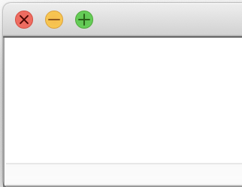
Updating Variables
Console Programs
int life = 42;
life = 42 – life;
life = 15;
life = life / 2; println(life * 3);
life
21
7
15
42
0
Graphics Programs
GRect rectR = new GRect(100, 100);
rectR.setColor(Color.RED);
GRect rectB = new GRect(100, 100);
rectB.setColor(Color.BLUE);
rectB = rectR;
add(rectB, 0, 0);
🤔
rectR
rectB

Slide 3
So Many Boxes
int life = 42;
double d = 14.0 / 2.5;
String s = "This is a string";
GRect rect = new GRect(width, height);
GRect rect = new GRect(x, y, width, height);
We can create many types of variables in Java!!

Slide 4
Animation loop
int count = 0;
GLabel countDisplay = new GLabel("" + count);
add(countDisplay, 1,50);
while(true) {
// updates text of label
countDisplay.setLabel("" + count);
count += 1;
/* What happens when we insert * the code from cases 1, 2, and 3? */
}
(1) if (count > 10) { break;
}
pause(500);
(2) // nothing
(3) pause(500);
🤔

Slide 5
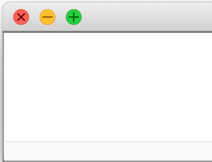


Animation loop
int count = 0;
GLabel countDisplay = new GLabel("" + count);
add(countDisplay, 1,50);
while(true) {
// updates text of label
countDisplay.setLabel("" + count);
count += 1;
/* What happens when we insert * the code from cases 1, 2, and 3? */
}
(1) if (count > 10) { break;
}
pause(500);
(2) // nothing
(3) pause(500);

Slide 6
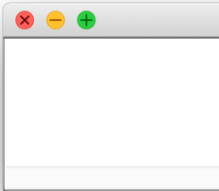
Animation loop
int count = 0;
GLabel countDisplay = new GLabel("" + count);
add(countDisplay, 1,50);
while(true) {
// updates text of label
countDisplay.setLabel("" + count);
count += 1;
/* What happens when we insert * the code from cases 1, 2, and 3? */
}
(1) if (count > 10) { break;
}
pause(500);
(2) // nothing
(3) pause(500);

Slide 7
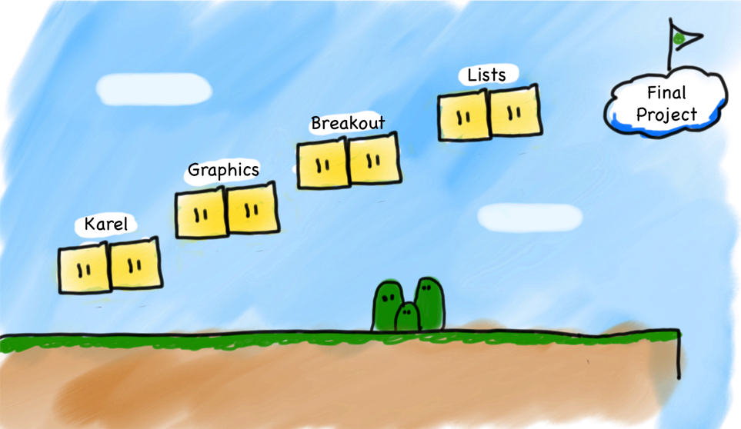
Our Second Step
Methods
Notes:
Let's just jump straight into it!

Slide 8


Today’s Goals
What is a method and how do we talk about it?
How do we define our own methods?
What is happening when we call a method?

Slide 9
Calling Methods
Methods
turnRight();
move();
readInt(“Int please! ”);
println(“hello world”);
rect.getX();
drawRobotFace();
rect.setLocation(10, 20);
Today, we will learn exactly what these methods are doing!

Slide 10

Defining a Method
private void turnRight() {
turnLeft();
turnLeft();
turnLeft();
}

Slide 11
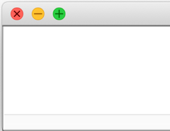

Defining a Method
public void run() {
printAverage1();
printAverage2();
}
private void printAverage1() {
double a = 5.0;
double b = 10.2;
double sum = a + b;
double mid = sum / 2;
println(mid);
}
private void printAverage2() {
double a = 6; // int 6 → double 12.0
double b = 18.0;
double sum = a + b;
double mid = sum / 2;
println(mid);
}
7.6
12.0
But wait…I thought methods help reuse code!
🤔
Notes:
what is the output? discuss

Slide 12
Methods are Ovens
Java methods can take in data and return other data!!
parameter
bakeInOven
return value

Slide 13
Ovens are Methods
Java methods can take in data and return other data!!
You don’t need a different oven for lahmacun. Use the same one.
bakeInOven
parameter
return value

Slide 14
Ovens are Methods
Java methods can take in data and return other data!!
Olive oil
bakeInOven
parameter
return value
Not all inputs work.

Slide 15
The Java method
public void run() {
double mid1 = average(5.0, 10.2);
println(mid1);
double mid2 = average(6, 18);
println(mid2);
}
private double average(double a, double b) {
double sum = a + b;
return sum / 2;
}
method “call”
method name
7.6
12.0
method definition
average(double a, double b) is a method that:
Takes as input two doubles (a and b).
Outputs a double
Averages the two inputs.
Notes:
We will get here step by step!

Slide 16
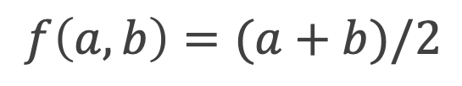
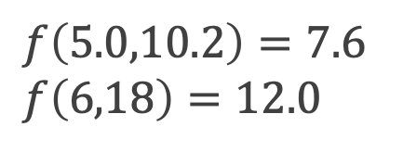
The Algebra Version
public void run() {
double mid1 = average(5.0, 10.2);
println(mid1);
double mid2 = average(6, 18);
println(mid2);
}
private double average(double a, double b) {
double sum = a + b;
return sum / 2;
}
7.6
12.0
Method definition:
Method calls:
$$f\left(a,b\right)=(a+b)/2$$
$f\left(5.0,10.2\right)=7.6$
$f\left(6,18\right)=12.0$

Slide 17
The Java method
public void run() {
double mid1 = average(5.0, 10.2);
println(mid1);
double mid2 = average(6, 18);
println(mid2);
}
private double average(double a, double b) {
double sum = a + b;
return sum / 2;
}
Return type
Parameters
7.6
12.0

Slide 18
Anatomy of a method
public void run() {
double mid1 = average(5.0, 10.2);
println(mid1);
double mid2 = average(6, 18);
println(mid2);
}
private double average(double a, double b) {
double sum = a + b;
return sum / 2;
}
7.6
12.0
method body
return value

Slide 19
Calling and Defining Methods
arguments
public void run() {
double mid1 = average(5.0, 10.2);
println(mid1);
double mid2 = average(6, 18);
println(mid2);
}
private double average(double a, double b) {
double sum = a + b;
return sum / 2;
}
method “call”
parameters
7.6
12.0
method definition
arguments: calling (with actual int values)
vs
parameters: defining method input (any int)
Notes:
so to summarize

Slide 20
Explaining the void and the ()
public void run() {
printIntro();
}
private void printIntro( ) {
println("Welcome to class");
println("It's the best part of my day.");
// nothing here
}
return type
name
parameters
⚠️ void methods don’t need a return.
printIntro() is a method that:
Takes no parameters.
Returns nothing.
It just always prints:
Welcome to class
It's the best part of my day.

Slide 21
Methods Dear to Our Heart
Parameter
Types?
Return
Types?
Method call
average(5.0, 10.2);
double,double
double
printIntro();
(nothing)
void
turnRight();
(nothing)
void
readInt("Enter age: ");
String
int
println(”You’re cool!");
String
void
getWidth();
(nothing)
double
rect.setLocation(10,20);
double,double
void
🤔

Slide 22

Questions?
TL;DR: (too long; don’t read)
(means the summary of what just happened)
bakeInOven
parameter
return value

Slide 23
Today’s Goals
✓
What is a method and how do we talk about it?
How do we define our own methods?
What is happening when we call a method?

Slide 24
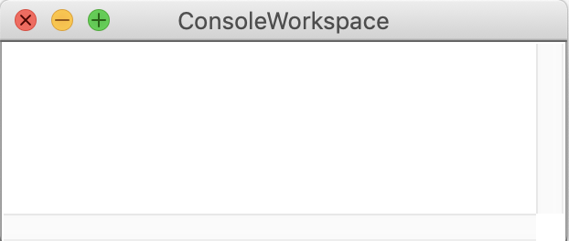
Parameter Example
public void run() {
printOpinion(5);
}
private void printOpinion(int num) {
if(num == 5) {
println("I love 5!");
} else {
println("Whatever");
}
}
I love 5!
???
Notes:
Let’s understand how to read methods.

Slide 25
Multiple Returns are OK
private String getMonthName(int index) {
if (index == 0) {
return "January";
}
if (index == 1) {
return "February";
}
...
return "Unknown";
}
getMonthName(0)?
getMonthName(1)?
getMonthName(200)?
returns
returns
returns
"January"
"February"
"Unknown"

Slide 26
Multiple Returns are OK, but…
private String getMonthName(int index) {
if (index == 0) {
return "January";
}
if (index == 1) {
return "February";
}
...
// return "Unknown";
}
This method must return a result of type String
For all possible arguments of this type, something must be returned!

Slide 27
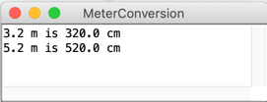
Parameter + Returns
public void run() {
double conversion = metersToCm(3.2);
println("3.2 m is " + conversion + " cm");
println("5.2 m is " + metersToCm(5.2) + " cm");
}
private ??????? metersToCm(???????) {
/* Fill this in too */
}
Step (1)
Step (2)
Let’s program together!
🤔
Notes:
Go straight to programming

Slide 28
Parameter + Returns
public void run() {
double conversion = metersToCm(3.2);
println(”3.2 m is " + conversion + " cm");
println("5.2 m is " + metersToCm(5.2) + " cm");
}
private double metersToCm(double meters) {
return meters * 100;
}
⚠️ You must name your input variables!
Let’s program together!

Slide 29
Parameter + Returns
public void run() {
double conversion = metersToCm(3.2);
println("3.2 m is " + conversion + " cm");
println("5.2 m is " + metersToCm(5.2) + " cm");
}
private double metersToCm(double meters) {
return meters*100;
}
⚠️ Any non-void method must return something!
Let’s program together!

Slide 30
Summary: Defining a Method
visibility type nameOfMethod(parameter types and names) {
statements
}
visibility: usually private or public
type: type returned by method
int , double , etc. must include a double value!
Can be void to indicate that nothing is returned
Input parameters: information passed into method
Must declare variable type AND variable name! (like double meter)
Can be empty ()

Slide 31
Today’s Goals
✓
What is a method and how do we talk about it?
How do we define our own methods?
What is happening when we call a method?
✓
Notes:
Questions here

Slide 32

Java Execution of Methods
“equals”
Evaluate right hand side
Store result in variable on left hand side
=

Slide 33
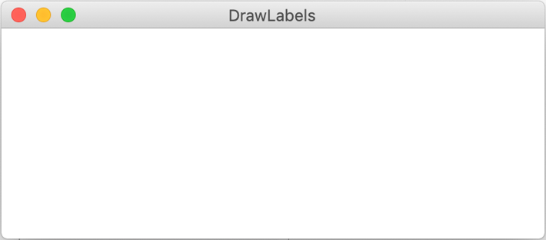
public void run() {
GLabel redLabel = coloredLabel("Red hello", Color.RED);
add(redLabel, 50, 50);
GLabel label = coloredLabel("hello", Color.BLUE);
add(label, 100, 100);
}
private GLabel coloredLabel(String text, Color fill) {
GLabel label = new GLabel(text);
label.setFont("Calibri-50");
label.setColor(fill);
return label;
}
What happens when we run this program?
Red hello
hello
🤔

Slide 34
public void run() {
GLabel redLabel = coloredLabel("Red hello", Color.RED);
add(redLabel, 50, 50);
GLabel label = coloredLabel(”hello", Color.BLUE);
add(label, 100, 100);
}
private GLabel coloredLabel(String text, Color fill) {
GLabel label = new GLabel(text);
label.setFont("Calibri-50");
label.setColor(fill);
return label;
}
What happens when we run this program?

Slide 35

public void run() {
GLabel redLabel = coloredLabel("Red hello", Color.RED);
add(redLabel, 50, 50);
GLabel label = coloredLabel(”hello", Color.BLUE);
add(label, 100, 100);
}
private GLabel coloredLabel(String text, Color fill) {
GLabel label = new GLabel(text);
label.setFont("Calibri-50");
label.setColor(fill);
return label;
}
Evaluate right hand side
Store result in variable on left hand side

Slide 36
public void run() {
GLabel redLabel = coloredLabel("Red hello", Color.RED);
add(redLabel, 50, 50);
GLabel label = coloredLabel("hello", Color.BLUE);
add(label, 100, 100);
}
private GLabel coloredLabel(String text, Color fill) {
GLabel label = new GLabel(text);
label.setFont("Calibri-50");
label.setColor(fill);
return label;
}
text
"Red hello"
fill
Color.RED
Evaluate right hand side
Store result in variable on left hand side

Slide 37
public void run() {
GLabel redLabel = coloredLabel("Red hello", Color.RED);
add(redLabel, 50, 50);
GLabel label = coloredLabel(”hello", Color.BLUE);
add(label, 100, 100);
}
private GLabel coloredLabel(String text, Color fill) {
GLabel label = new GLabel(text);
label.setFont("Calibri-50");
label.setColor(fill);
return label;
}
text
"Red hello"
fill
Color.RED
label
Red hello
Red hello
Red hello

Slide 38
public void run() {
GLabel redLabel = coloredLabel("Red hello", Color.RED);
add(redLabel, 50, 50);
GLabel label = coloredLabel("hello", Color.BLUE);
add(label, 100, 100);
}
private GLabel coloredLabel(String text, Color fill) {
GLabel label = new GLabel(text);
label.setFont("Calibri-50");
label.setColor(fill);
return label;
}
text
"Red hello"
fill
Color.RED
label
Red hello

Slide 39
public void run() {
GLabel redLabel = coloredLabel("Red hello", Color.RED);
add(redLabel, 50, 50);
GLabel label = coloredLabel(”hello", Color.BLUE);
add(label, 100, 100);
}
private GLabel coloredLabel(String text, Color fill) {
GLabel label = new GLabel(text);
label.setFont("Calibri-50");
label.setColor(fill);
return label;
}
Red hello
Red label
redLabel
Red hello

Slide 40
public void run() {
GLabel redLabel = coloredLabel("Red hello", Color.RED);
add(redLabel, 50, 50);
GLabel label = coloredLabel(”hello", Color.BLUE);
add(label, 100, 100);
}
private GLabel coloredLabel(String text, Color fill) {
GLabel label = new GLabel(text);
label.setFont("Calibri-50");
label.setColor(fill);
return label;
}
Red hello
redLabel
Red hello

Slide 41
public void run() {
GLabel redLabel = coloredLabel("Red hello", Color.RED);
add(redLabel, 50, 50);
GLabel label = coloredLabel("hello", Color.BLUE);
add(label, 100, 100);
}
private GLabel coloredLabel(String text, Color fill) {
GLabel label = new GLabel(text);
label.setFont("Calibri-50");
label.setColor(fill);
return label;
}
text
"hello"
fill
Color.BLUE
Red hello
redLabel
Red hello

Slide 42
public void run() {
GLabel redLabel = coloredLabel("Red hello", Color.RED);
add(redLabel, 50, 50);
GLabel label = coloredLabel("hello", Color.BLUE);
add(label, 100, 100);
}
private GLabel coloredLabel(String text, Color fill) {
GLabel label = new GLabel(text);
label.setFont("Calibri-50");
label.setColor(fill);
return label;
}
text
"hello"
fill
Color.BLUE
label
hello
Red hello
hello
hello
redLabel
Red hello

Slide 43
public void run() {
GLabel redLabel = coloredLabel("Red hello", Color.RED);
add(redLabel, 50, 50);
GLabel label = coloredLabel("hello", Color.BLUE);
add(label, 100, 100);
}
private GLabel coloredLabel(String text, Color fill) {
GLabel label = new GLabel(text);
label.setFont("Calibri-50");
label.setColor(fill);
return label;
}
text
"hello"
fill
Color.BLUE
label
Red hello
hello
redLabel
Red hello

Slide 44
public void run() {
GLabel redLabel = coloredLabel("Red hello", Color.RED);
add(redLabel, 50, 50);
GLabel label = coloredLabel("hello", Color.BLUE);
add(label, 100, 100);
}
private GLabel coloredLabel(String text, Color fill) {
GLabel label = new GLabel(text);
label.setFont("Calibri-50");
label.setColor(fill);
return label;
}
label
hello
Red hello
label
hello
redLabel
Red hello

Slide 45
Questions?

Slide 46
More Examples

Slide 47
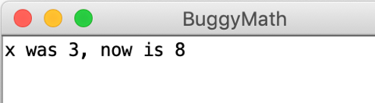
Bad Times with Methods
⚠️
public void run() {
int x = 3;
int prevX = x;
addFive(x);
println("x was " + prevX + ", now" + x);
}
private void addFive(int x) {
x += 5;
println(x);
}
(intention)
⚠️
⚠️
🤔
There are three bugs in this program!
Notes:
Go to program before review

Slide 48
Good Times with Methods
public void run() {
int x = 3;
int prevX = x;
x = addFive(x);
println("x was " + prevX + ", now" + x);
}
private int addFive(int x) {
x += 5;
return x;
}
At the end of these slides, there is a walkthrough of how Java runs this program.
That’s more like it!

Slide 49
Changed Name
private void run() {
int num = 5;
cow(num);
}
private void cow(int grass) {
println(grass);
}

Slide 50
Changed Name
private void run() {
int num = 5;
cow(num);
}
num
5
private void cow(int grass) {
println(grass);
}

Slide 51
Changed Name
private void run() {
int num = 5;
cow(num);
}
5
num
5
private void cow(int grass) {
println(grass);
}
grass
5
5

Slide 52
Same Variable
private void run() {
int num = 5;
cat();
}
private void cat() {
int num = 10;
println(num);
}

Slide 53
Same Variable
private void run() {
int num = 5;
cat();
}
num
5
private void cat() {
int num = 10;
println(num);
}

Slide 54
Same Variable
private void run() {
int num = 5;
cat();
}
num
5
private void cat() {
int num = 10;
println(num);
}
num
10
10

Slide 55
Today’s Goals
✓
What is a method and how do we talk about it?
How do we define our own methods?
What is happening when we call a method?
✓
✓

Slide 56
Review
A method:
parameters
return value
private int addFive(int x) {
x += 5;
return x;
}
If you declare a return type,
you must return a value of that type.
private void cat() {
int num = 10;
println(num);
}
void: no return values
(): no parameters.
println()is NOT return!!!!

Slide 57
Today’s material is difficult.
👍 Good job surviving 👍
🙋‍♂️Bring your questions to section!🙋‍♀️
Mad Methods

Slide 58
Two different x’s (for your viewing pleasure)
These are not the same x!
public void run() {
int x = 3;
int prevX = x;
x = addFive(x);
println("x was " + prevX + ", now" + x);
}
private int addFive(int x) {
x += 5;
return x;
}
Not covered in lecture;
this is just for clarification

Slide 59
Two different x’s (for your viewing pleasure)
Let’s rename this one.
public void run() {
int x = 3;
int prevX = x;
x = addFive(x);
println("x was " + prevX + ", now" + x);
}
private int addFive(int y) {
y += 5;
return y;
}
Not covered in lecture;
this is just for clarification

Slide 60
Two different x’s (for your viewing pleasure)
public void run() {
int x = 3;
int prevX = x;
x = addFive(x);
println("x was " + prevX + ", now" + x);
}
x
3
prevX
3
private int addFive(int y) {
y += 5;
return y;
}
Not covered in lecture;
this is just for clarification

Slide 61
Two different x’s (for your viewing pleasure)
public void run() {
int x = 3;
int prevX = x;
x = addFive(3);
println("x was " + prevX + ", now" + x);
}
x
3
prevX
3
private int addFive(int y) {
y += 5;
return y;
}
y
3
Not covered in lecture;
this is just for clarification

Slide 62
Two different x’s (for your viewing pleasure)
public void run() {
int x = 3;
int prevX = x;
x = addFive(x);
println("x was " + prevX + ", now" + x);
}
x
3
prevX
3
private int addFive(int y) {
y += 5;
return y;
}
y
8
Not covered in lecture;
this is just for clarification

Slide 63
Two different x’s (for your viewing pleasure)
public void run() {
int x = 3;
int prevX = x;
x = addFive(x);
println("x was " + prevX + ", now" + x);
}
x
8
prevX
3
private int addFive(int y) {
y += 5;
return y;
}
x was 3 now 8
Not covered in lecture;
this is just for clarification

Slide 64
Two different x’s (for your viewing pleasure)
public void run() {
int x = 3;
int prevX = x;
x = addFive(x);
println("x was " + prevX + ", now" + x);
}
private int addFive(int x) {
x += 5;
return x;
}
Renaming this back to x does not change the program behavior!
x was 3 now 8
Not covered in lecture;
this is just for clarification

Slide 65

Boolean

Slide 66
Boolean Variable
boolean karelIsAwesome = true;
boolean myBool = 1 < 2;

Slide 67
Boolean Operations
boolean a = true;
boolean b = false;
//This is false
boolean a_and_b = a && b;
//This is true
boolean a_or_b = a || b;
// This is false
boolean not_a = !a;

Slide 68

Now that’s style!

